Slide 1

Notes:
Hello, I’m glad to give you the final presentation on our project called “A Dynamic Parking Spot Allocation Based on Web”

Slide 2


















Notes:
Before we start, our team's name is Peter Parker which is consisted of 5 members, Jiwoo, Jungkyun, Byeonggyu from Korea Chungnam National University. Andy and Hazza who are Purdue students has helped with this project.

Slide 3



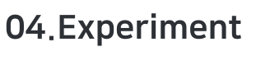

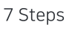






Notes:
The presentation will proceed with this 5 section.

Slide 4


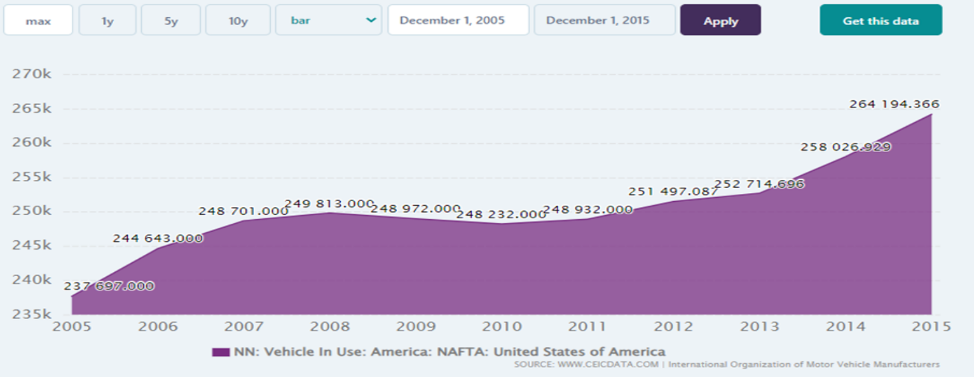
Notes:
Parking Problems, according to this data sets, the numbers of registered vehicles are constantly increasing in the US which causes parking problems.

Slide 5
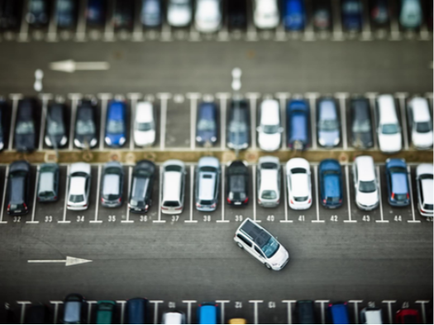
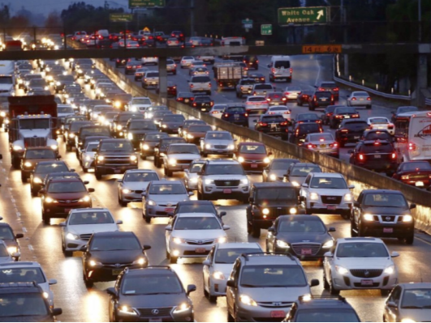
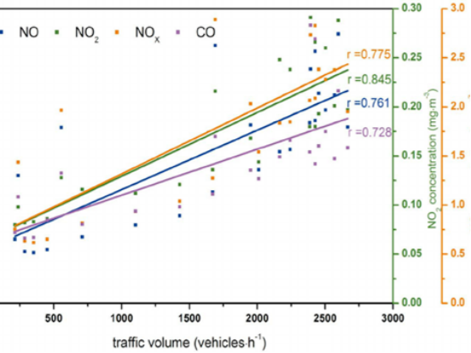



Notes:
To be specific, the issue arises from the fact that private vehicles spend most of their time being parked.
There is not enough parking space to accommodate overflowing vehicles. And 30% of traffic is caused by insufficient parking space, followed by vehicle emissions.

Slide 6















Using intuitive UI
Easy for users to use
Control spots in any time
Adjust according to demand
Install to any parking lots
Utilize limited parking space
Manage parking lot in real-time
Check seats availability
Notes:
In order to address parking problems, we conduct dynamic technology. This technology offers four features: simplicity, flexibility, economy, and convenience.
We start by providing an intuitive User Interface in the Web so users can easily handle the product. Next, an administrator adjusts parking spots flexibly according to the demand.
Then our product can be installed to any parking lots and utilized the limited parking spaces so that users can save money.
Lastly, the administrator will manage the parking lot as well as allowing users to check the seat availability in real-time.

Slide 7

















Dynamic parking pricing
Calculate the nearest empty spot
Mathematical Calculation
Facial recognizing system
Vehicle license plate recognizing
Access Authority
Monitoring system
Database system
Continuous Management
Arduino with modules
Raspberry pi with modules
Real-Time Data Sharing
Notes:
As our parking system can be conducted in the best way, we compared and analyzed similar technologies. There are four method that we have investigated.
From the top, they consist of Algorithm to IoT systems. And, each of these systems feature in terms of Mathematical Calculation to Real-time data sharing.
Among these system, we adopted the IoT system to adjust the information in real-time.

Slide 8


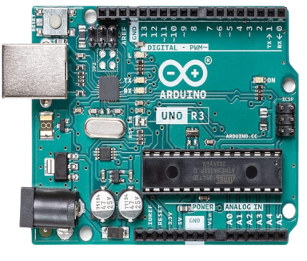


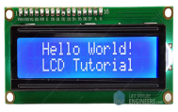


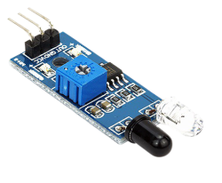

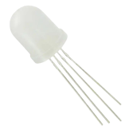
















Notes:
In order to implement our system, we have used a number of different options. In terms of the platform, we have chosen Node-Red over Thingsboard because it is more compatible with other devices.
In the mainboard, between price and performance, we chose Arduino, as our system does not require high performance.
In terms of modules, LCD display, RGB LED, and Infrared sensor were chosen in accordance with the project.
The technology is made available to customers via the Web so they can use it on any device.

Slide 9
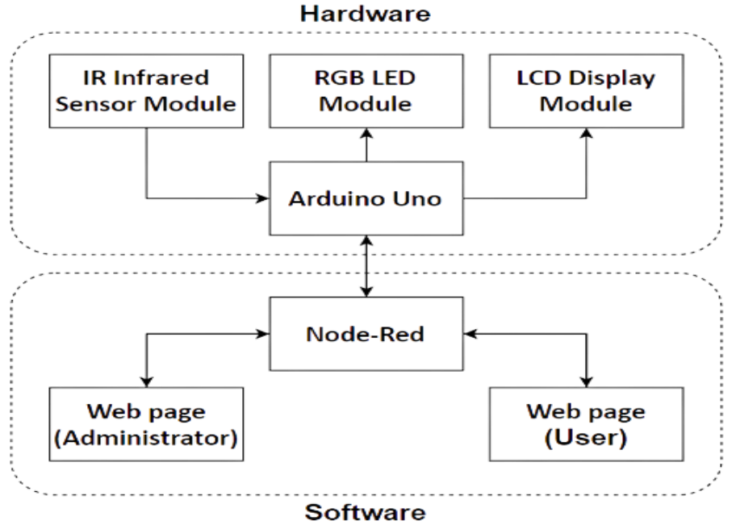
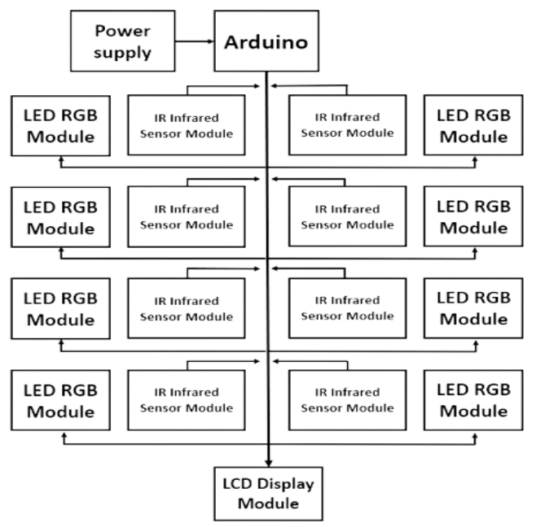

Notes:
With the devices that we chose, here is our system overview and hardware interface. After the aforementioned modules are installed on the Arduino, the Arduino and Node-Red are interconnected.
Once they are linked, Node-Red controls all devices including Web pages as platforms.
Next in the hardware Interface, we use one Arduino supplying power with USB to connect eight infrared and LED RGB modules so that it can accommodate eight parking spots.
As for the parking lot entrance, the LCD Display module is installed to check seats availability.

Slide 10
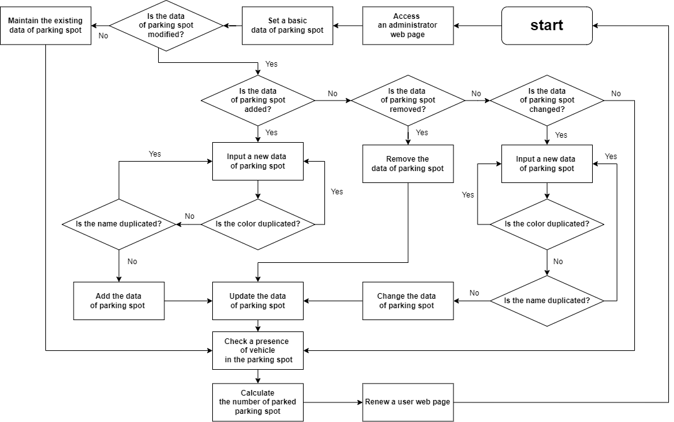

Notes:
In this flowchart, we show our process of the parking system. First, the system administrator accesses the manageable Web page and initializes parking spot status.
After the data is updated, the system will recognizes duplicate values.
If there is no duplicated value, the parking data will be updated when a parking spot is changed to a different color. An infrared sensor will then count how many cars are parked.
In addition to the Web page, all this updated information will also appear on the LCD Display.
I have been handling this part until now. From then, Jiwoo Park will take over.

Slide 11
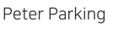

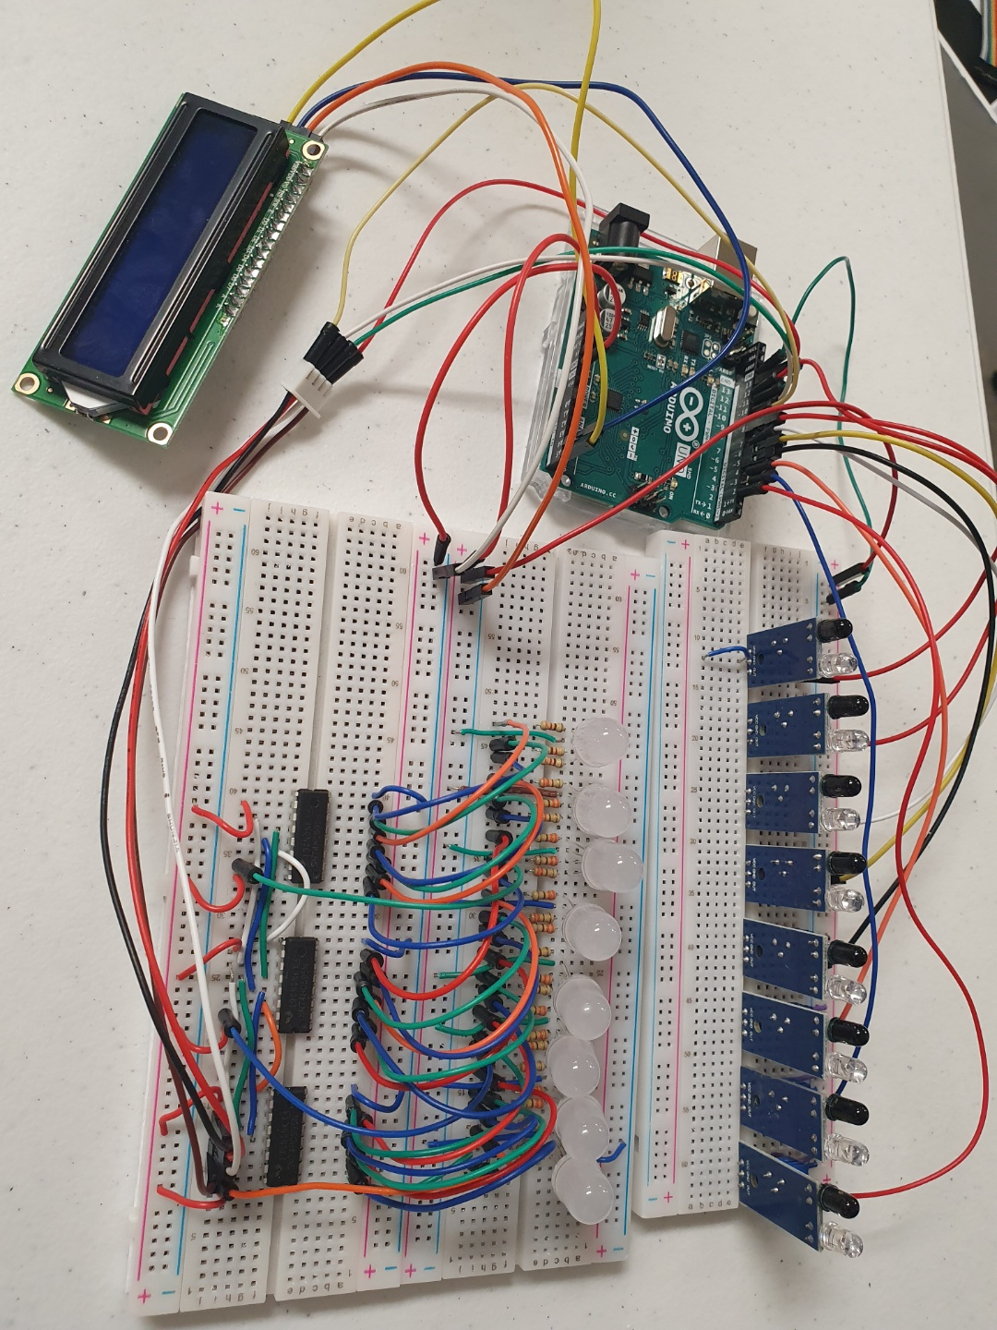
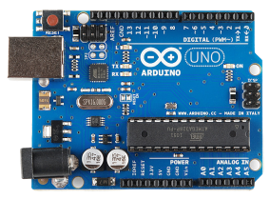
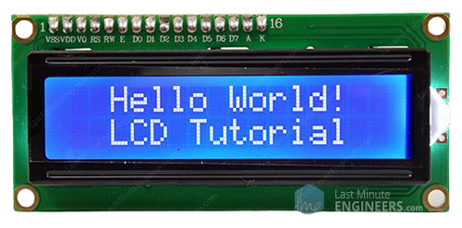


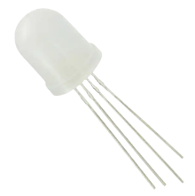


Arduino Uno
LCD Display
IR Infrared sensor
RGB LED
Notes:
Hello, I am Jiwoo Park, and I will explain the experiments we did with our system.
The first step is to connect each modules to the Arduino.
The image on the left side is the module that we will be using.

Slide 12

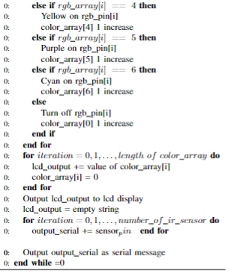
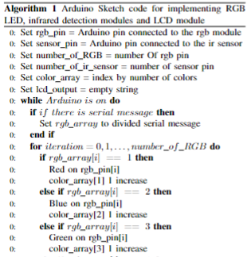

Notes:
The second step is to upload the basic settings to Arduino by using a program called Ardunio Sketch.
The image on the right side is Pseudocode.
The “while” iteration is executed when the Arduino is on. And there are three “for” iterations,
In the blue “for” iteration, Arduino sets RGB Led modules and in the red “for” iteration, LCD display is updated.
In the green “for” iteration, IR Infrared module’s value is checked.

Slide 13

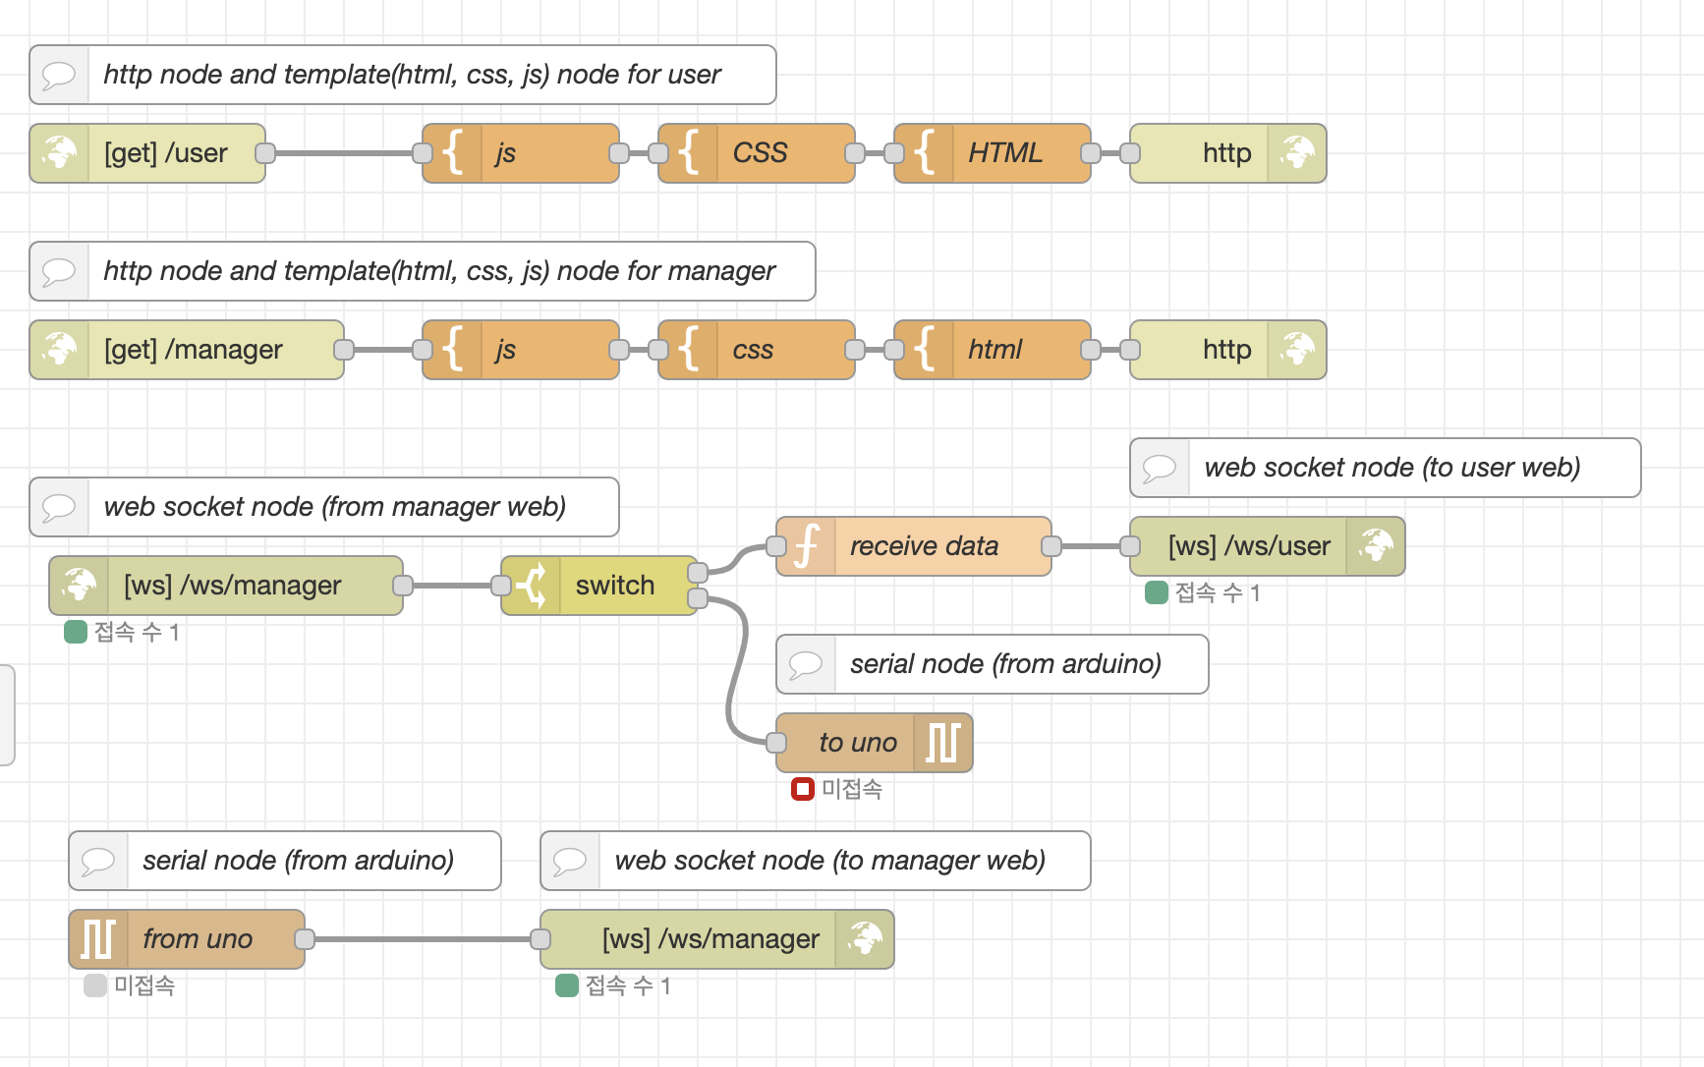

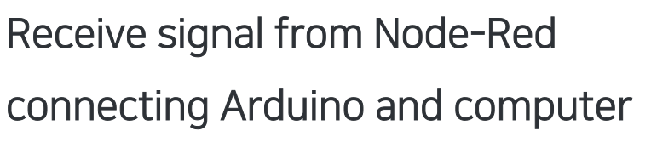
- HTTP Node
- Web Node
- Serial Node
- Web Socket Node
Notes:
For step 3 of the experiment is to use Node-Red which is a platform that is used to connect the Arduino and the computer which will allow the system to receive signals.
During this step, First the Web nodes which are consist of CSS, JS, HTML is connected through a HTTP node.
After this process, Arduino can interact with system by using Serial node. and Web Socket node makes the Web nodes to communicate each other.

Slide 14

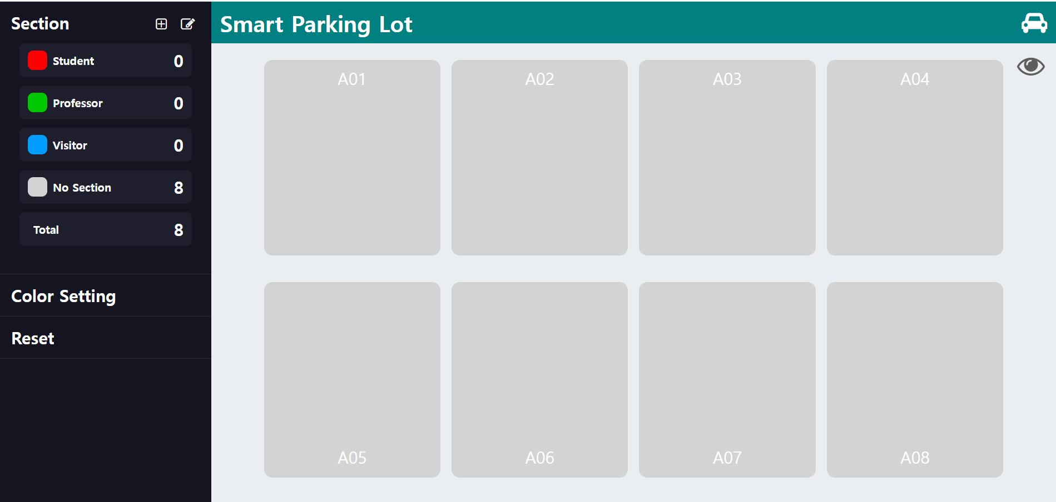

Notes:
As for the fourth step is to make the Manager web page.
The left side of the webpage are the controller options.
The manager can set data values to each parking spot by using the controller options.
The center part is a graphical schema that displays the parking lot.

Slide 15
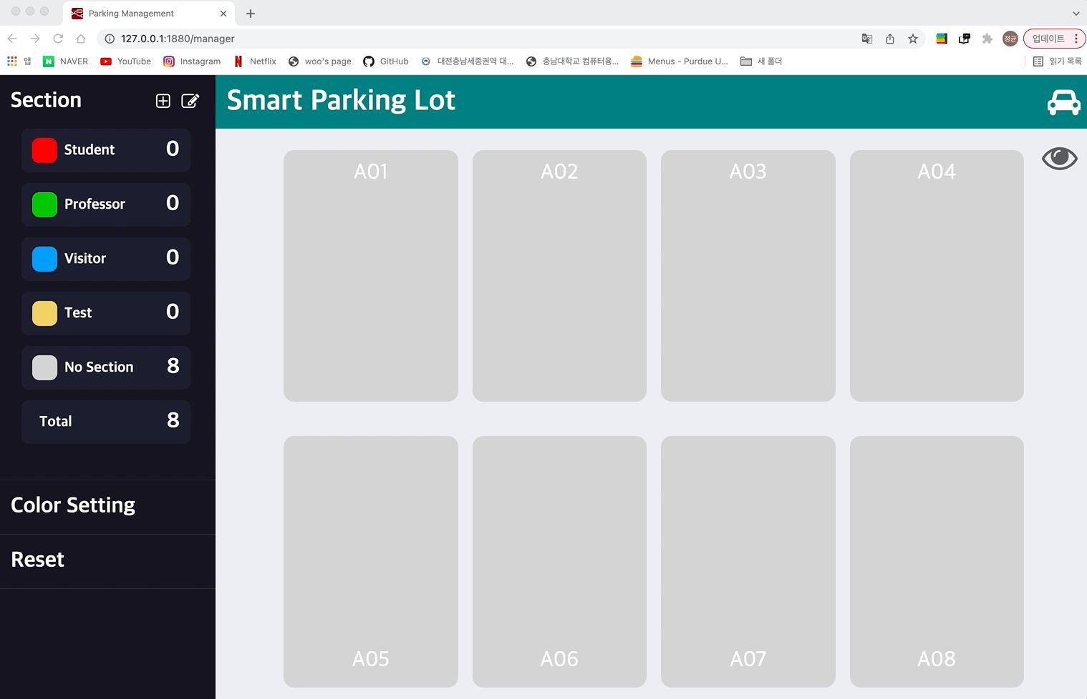
Notes:
As for experiment step 4 I will be explaining each part.
This is the color setting, when the color setting button is clicked, it is changed into color setting mode.
After selecting each parking spot and selecting the color, the section's list is updated.

Slide 16
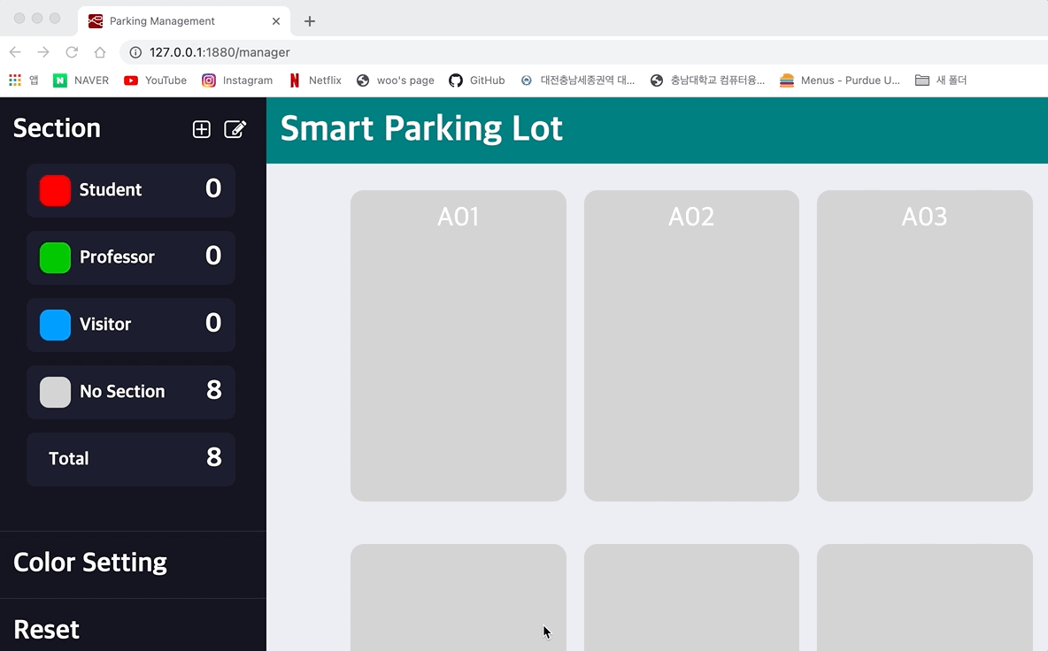
Notes:
And This is control of “Section”
A “+” button will be displayed on the left top side that allows adding of new parking spot to the data set.
If the data were to be added successfully, then the data will be displayed in the section part.

Slide 17
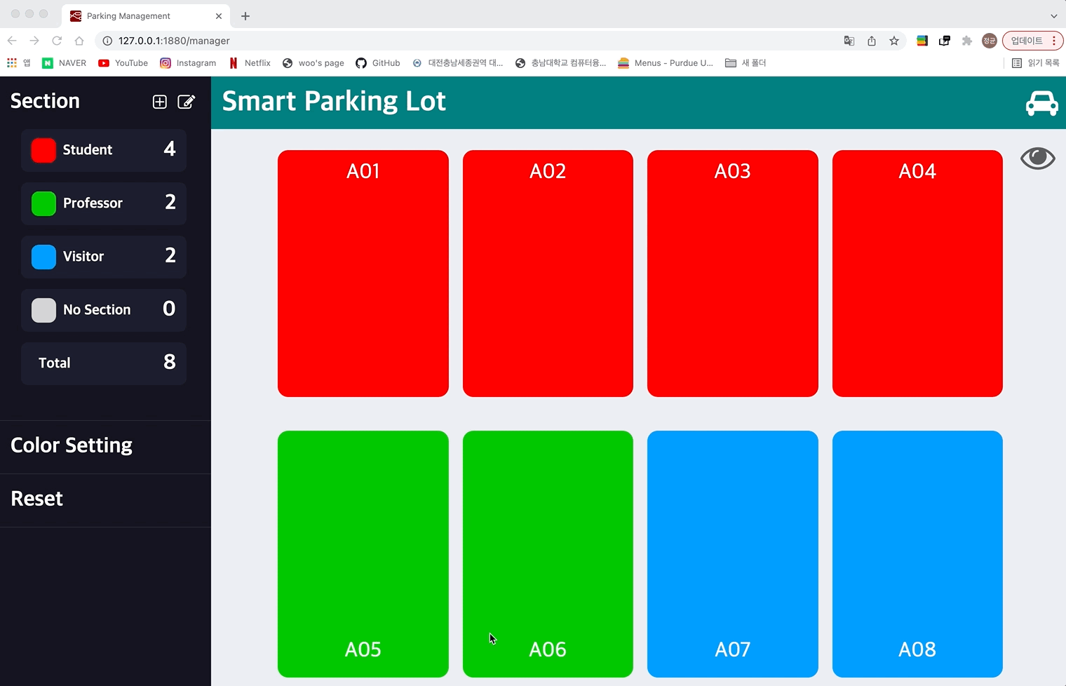
Notes:
Next is the removing and changing of data of the parking spots.
If the manager were to click the edit button that is next to the add button then the section part’s list will be changed.
When a color is clicked, the color will change and a name may also be retyped.

Slide 18
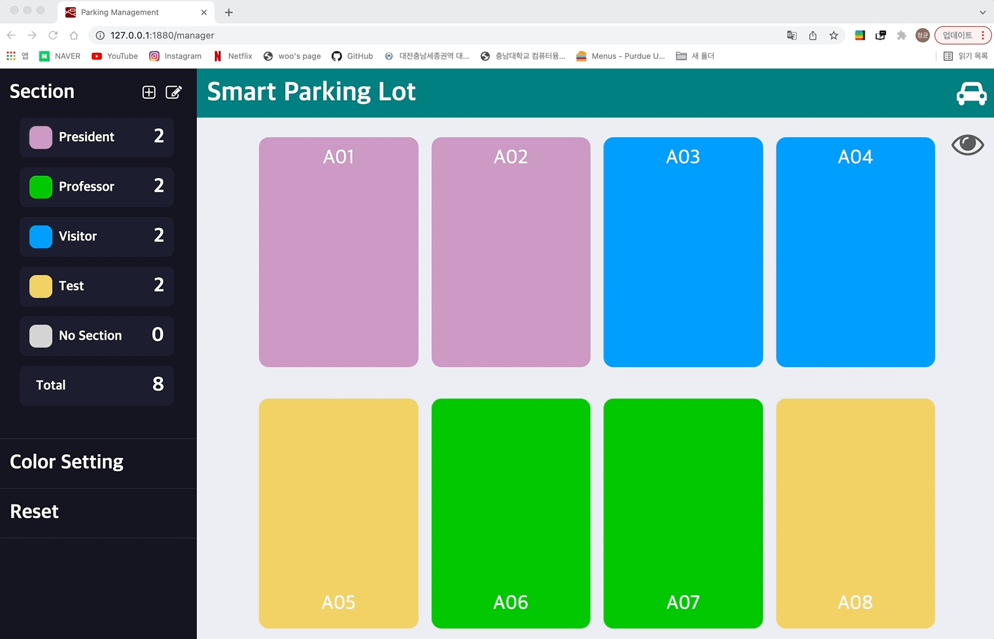
Notes:
And the manager can easily remove data by clicking the remove button that is displayed in the list
All changes will be saved if the check button is clicked at the bottom of the “Section ”.

Slide 19
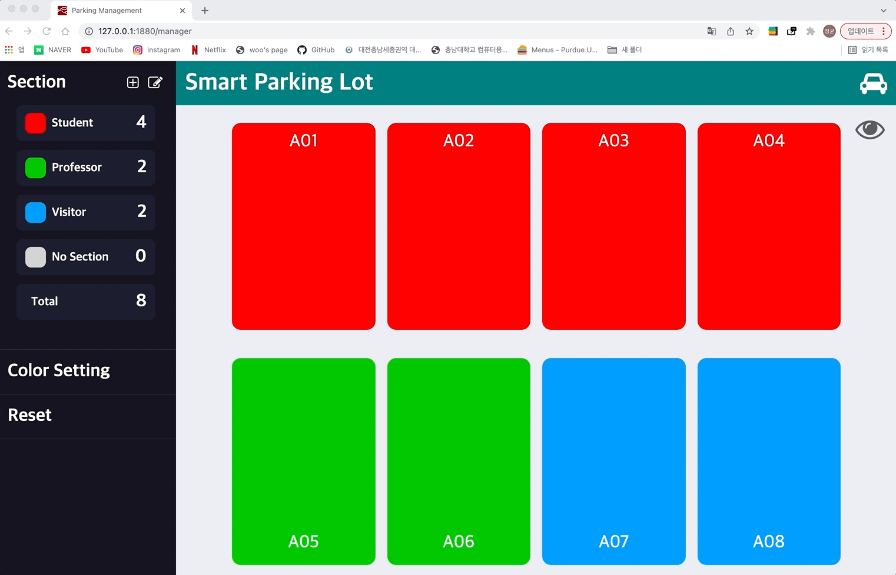
Notes:
And there is a reset button that allows managers to reset all data.

Slide 20
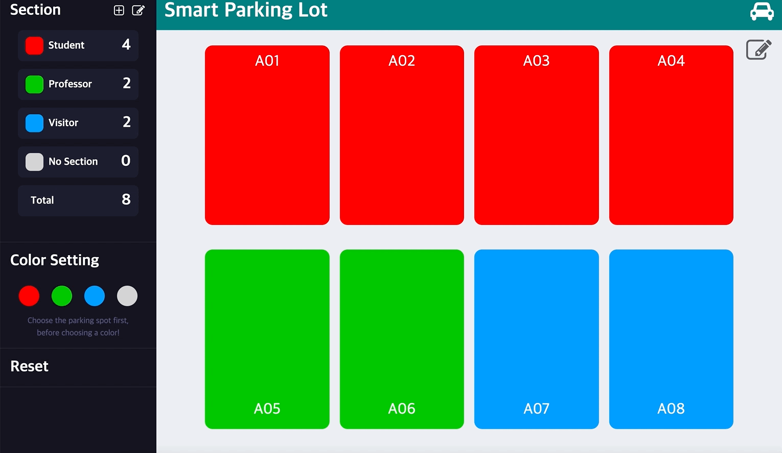
Notes:
Lastly If the vehicle is parked in the parking spot, the web page will mark the spot with icon

Slide 21

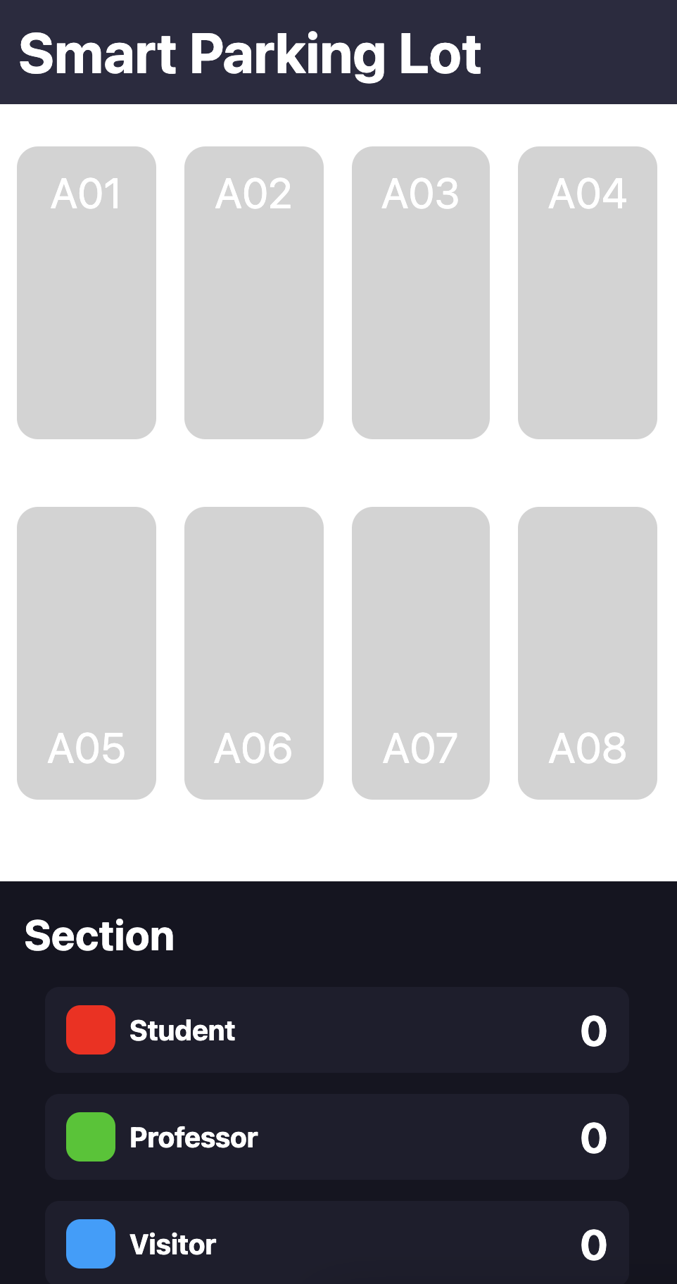
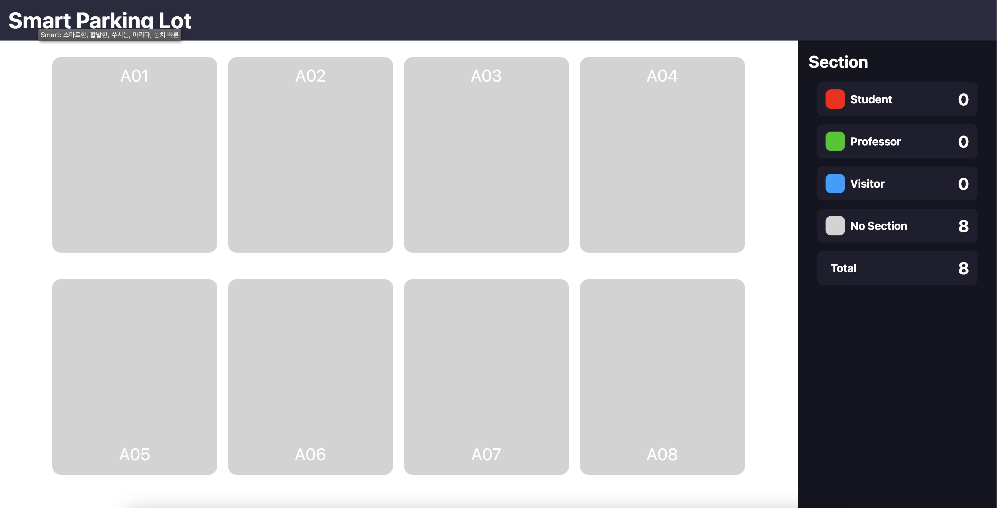

Notes:
The step 5 is to make user web page. Not only it adjusts automatically to the size of the screen.

Slide 22
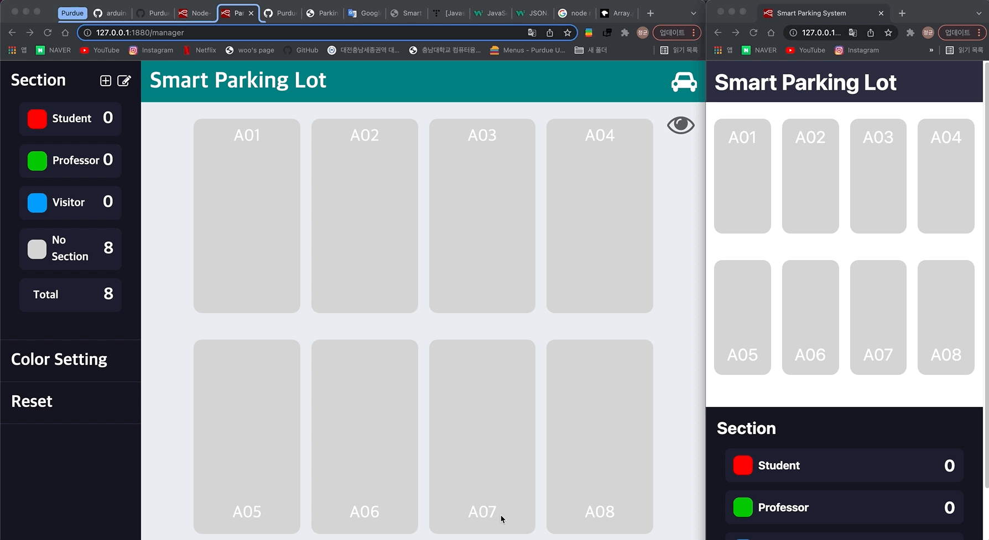
Manager web page ↓
↓ User web page
Notes:
But the information of the parking lot is updated in real time.

Slide 23

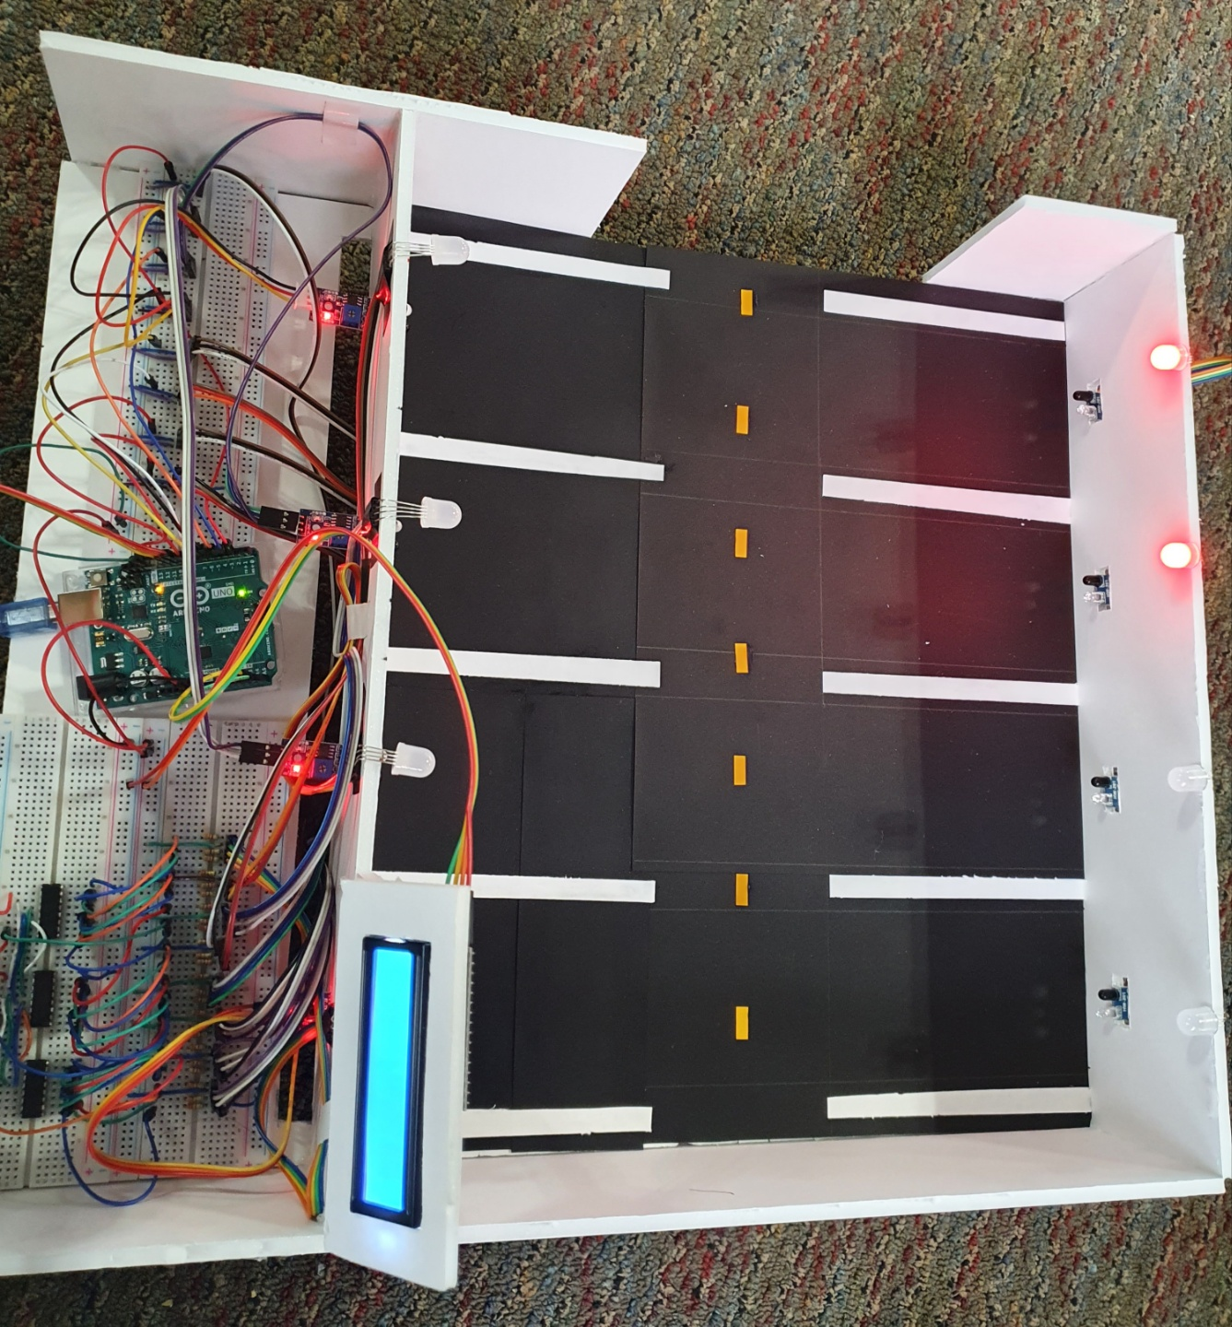

Notes:
As for the sixth step is to make a sample model of the parking lot.
In order to test the system, we made a sample model that has 8 parking spots
And the modules will be placed in each parking spot.

Slide 24

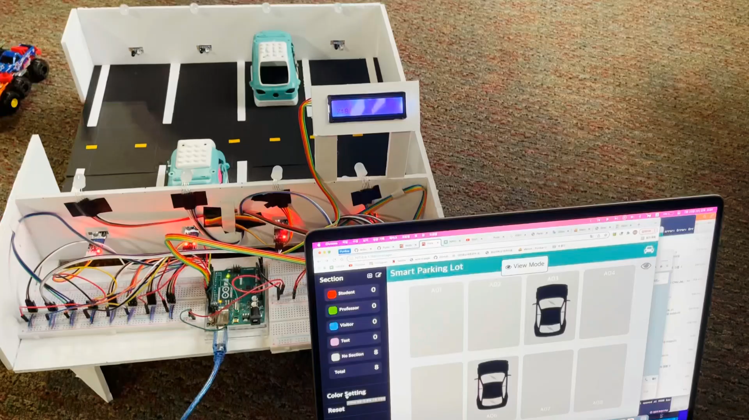

Notes:
And for our final step of the experiment is making the connection between the system and the sample model.
Here you can see how the system works.
If the manager web page sets the data, the sample model and user web page will update the information of the parking lot.
On the other hand, if the parking spot detects a vehicle, it will send the data to the manager web page.

Slide 25




The sample model is different from the real world
Limited to indoor
parking lot only
The visibility of RGB Led module
Notes:
As for the conclusion analysis, we have concluded 3 problems.
the first problem is that the system is limited to indoor parking lots only.
the second problem is that the sample model isn’t a matched in the real world as parking lots has many rules and standards.
Lastly, there is a problem with the visibility of the RGB Led module.

Slide 26





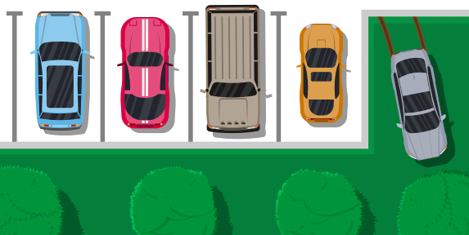








Notes:
As for the result in the system, when an event occur, each parking spot can be flexibly allocated,
which allows driver to park at unused parking spots which as a result can allow more vehicles to be accommodated by using this system.

Slide 27









Notes:
And finally for our future plan, we plan to solve the problems talked about on the previous slides
by applying rules and standards from real parking lots and making the LED lights more visible in outdoor parking lots.

Slide 28


Notes:
So, that’s all we have to say, thank you all for listening and if you have any questions please tell us.

